Slide 1

Wordle
Lizzie Healy and Emily Oh
Notes:
Lizzie

Slide 2
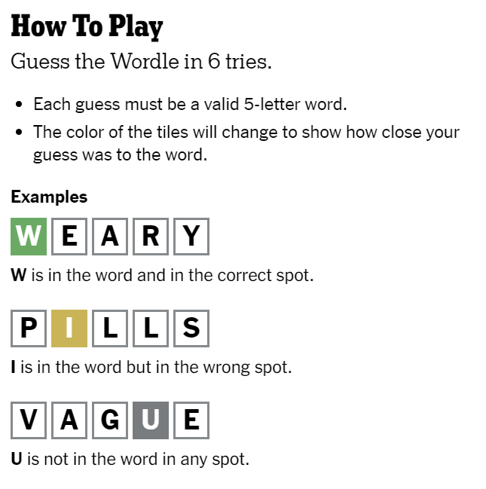
Rules of the Game:

Slide 3
Array versus Linked List
To store the guesses of the user and the 5-letter work options, we will be using an array for multiple reasons:
  All of the words will be exactly 5-letters, thus the array length is known
  Will not need to insert or delete at interior positions of the array
0
1
2
3
4
S
T
A
R
E
Notes:
Lizzie

Slide 4
Classes to Implement
Main
  Test and play the game
  Prompts reader for guesses, checks if guess is a word, checks if guess is correct, checks if letters are in the answer, allows for 6 guesses, ends game on loss or win
Wordle
  Contain all the methods necessary to make the game work
CSVReader
  Read the csv file of all possible five letter words

Slide 5
Methods to Implement
Color
  If the letter is in the word, but not the right position, then change that letter color to yellow
  If the letter is in the word and in the right position, then change letter color to green
pickWord
  Randomly picks a five letter word from the csv list to be the wordle word of the game
isWord
  Check to see if the user’s input is a real word (ie on the word list)
containsChar
  Checks if character is in character array
Correct
  Checks if the guessed word is correct

Slide 6
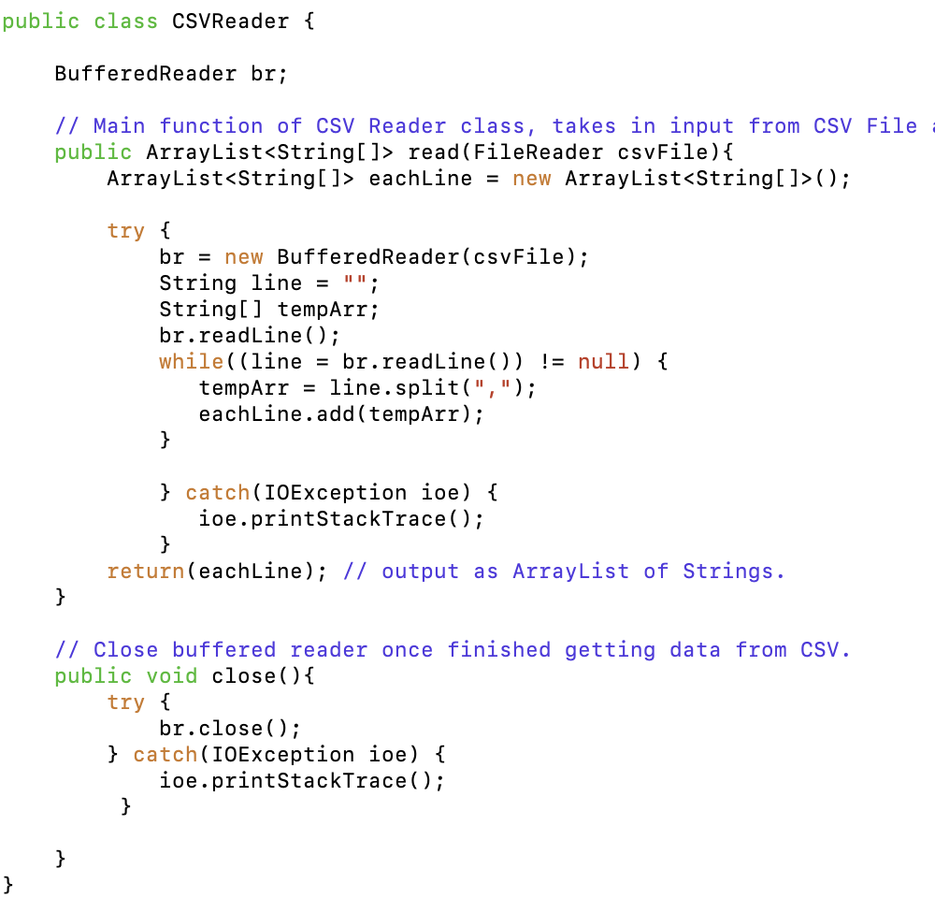
Read-in Component
In-order to check that the guesses are actual words and to obtain a 5-letter word as the answer we are using a CSV Reader to read-in a file containing all possible 5-letter words
  This file will be read in, made into an array and then added to an array containing all words
  The program will then randomly choose a word from this array to be the answer
  Each time a user makes a guess, the program will check that the word is in this list
Notes:
Lizzie

